Slide 1
Continued Fractions: How to Understand Self-Similar and Infinite Processes
Maninder Dhanauta
University of Toronto Scarborough
m.Dhanauta@mail.utoronto.ca

Slide 2
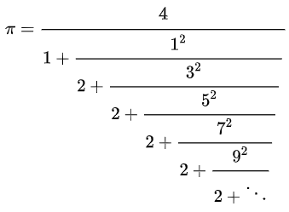
Overview
Part 1:
What is a continued fraction?
Evaluating an easy Continued Fraction (example)
More rigorous proof of the CF
Part 2:
Generally accepted theory of CF
Khinchin’s Constant

Slide 3
Overview
Part 1:
What is a continued fraction?
Evaluating an easy Continued Fraction (example)
More rigorous proof of the CF
Various other CFs evaluated via Python Script
Part 2:
Generally accepted theory of CF
Khinchin’s Constant

Slide 4
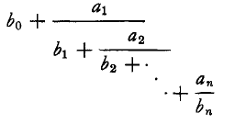
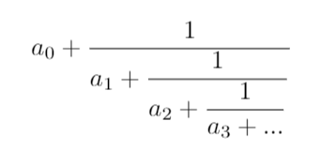

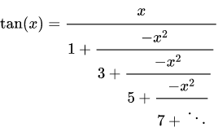
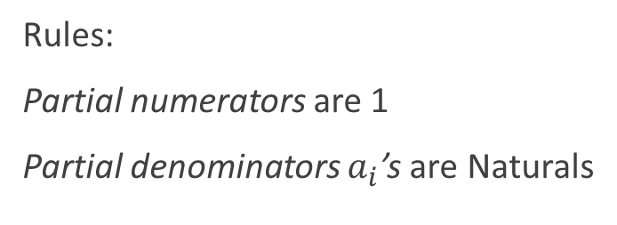
What is a Continued Fraction
General Form:
We will restrict our definition
Rules:
Partial numerators are 1
Partial denominators $a_{i}$’s are Naturals
Notes:
Mention connection to real analysis (dividing rationals and irrationals, measuring irrationality), connections to STIELTJES SUMMABILITY, parabola theorem basically read the introduction.
Then there’s finite vs. infinite, we talk about infinite
Fun fact about tan, pi and lambert 1760

Slide 5
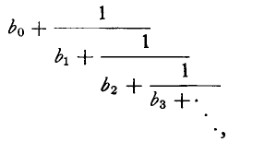


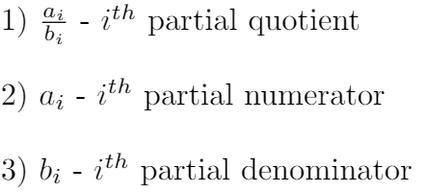
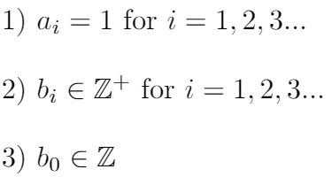
What is a Continued Fraction
General form:
Terminology:
Simple form:
Rules:
Simple/canonical Form when:
Notes:
Mention connection to real analysis (dividing rationals and irrationals, measuring irrationality), connections to STIELTJES SUMMABILITY, parabola theorem basically read the introduction.
Then there’s finite vs. infinite, we talk about infinite

Slide 6
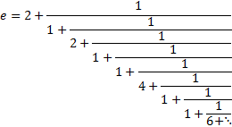
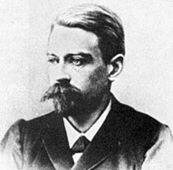
History of CF
Mathematicians were trying to understand infinity
Euler used them to prove irrationality of e
T.J Stieltjes used them to evaluate “semi-convergent” integrals/series (1890s)
Hamburger(1920) provided compete extension of the theory

Slide 7
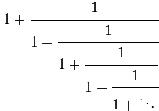
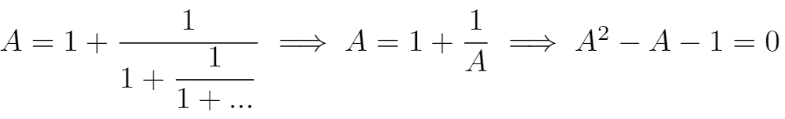
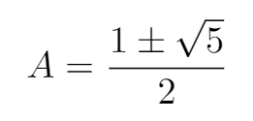

Consider the Simplest Infinite CF
How do we make sense of this?
What does it equal to?
There is a trick used commonly in Math competitions:
Let A equal to the expression!
Notes:
Try to evaluate : its between 1 and 2, Math comp tricks be like that, Trick not mathematically grounded, what if we didn’t know the trick? (We need a grounded method anyways)

Slide 8
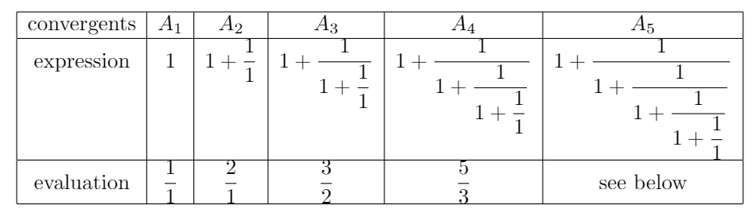



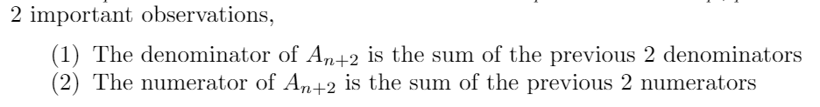

Consider the Simplest Infinite CF
Consider the nth approximant:
Already, we used CF to successfully related Fibonacci numbers to the Golden Ratio!!!

Slide 9
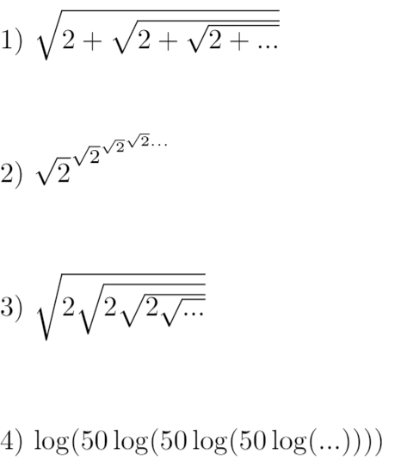
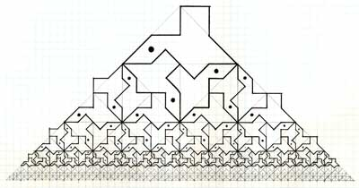
Exercises
Evaluate the following self similar expressions:
[is there another way to do 3?]
https://sites.google.com/site/davidbaileytessellations/self-similar-tessellations

Slide 10

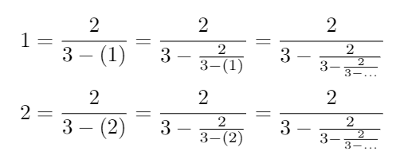
When Infinity Becomes Tricky
The trick makes some problematic assumption. It assumes the expression converges. This is very wrong because it can give nonsensical answers.
(If we show the expression converges, the trick is valid to use)
But there is another problem! Consider the following equalities:
Clearly infinity isn’t something to casually meddle with

Slide 11


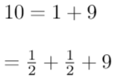




The Problem are Those …
They ask the reader to make assumes about infinity, which may vary from person to person
The use of dots causes the loss of information

Slide 12

Fixing the Infinity Problem
There are 3 things needed to evaluate infinite expressions/process:
An exact definition of the Process
An initial seed value for the process
An exact definition for its convergence

Slide 13
Proper proof of Simplest CF

Slide 14
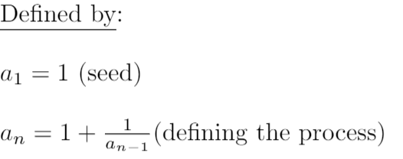
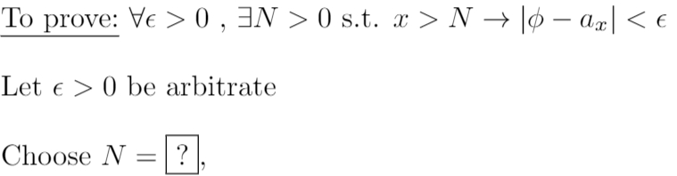
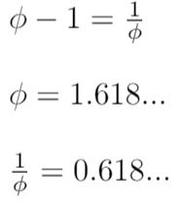

We know epsilon will tend to zero so the following must be less than 1:

Slide 15
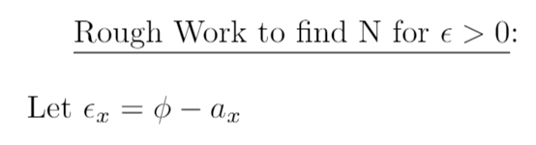

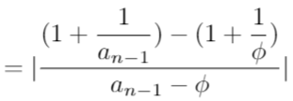




Consider:

Slide 16

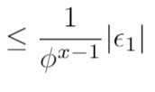

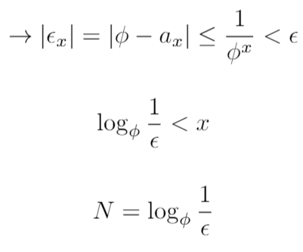
Q.E.D

Slide 17
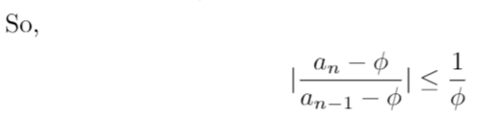



Q.E.D

Slide 18
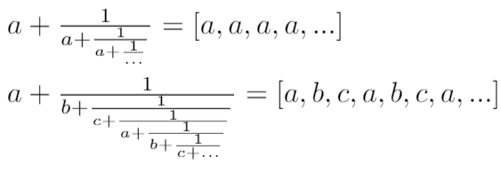

Convergence of a Family of Infinite CFs
The previous proof works for every self-similar infinite CF of the form:
“Simple continued fractions” have numerator 1s.
In general, if tail end repeats, we can prove the value from the trick is actually the limit.
(Note: every partial denom. must be positive)

Slide 19
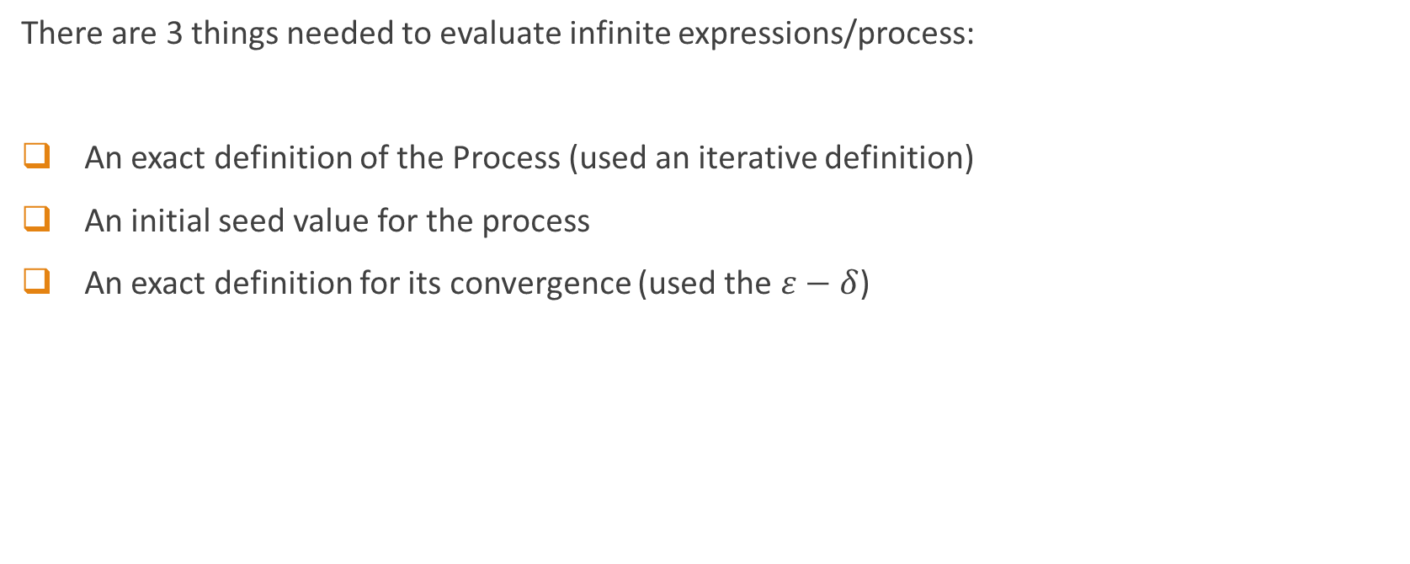
Fixing the Infinity Problem
There are 3 things needed to evaluate infinite expressions/process:
An exact definition of the Process (used an iterative definition)
An initial seed value for the process
An exact definition for its convergence (used the $ε−δ$)
Notes:
Convergence theorems

Slide 20
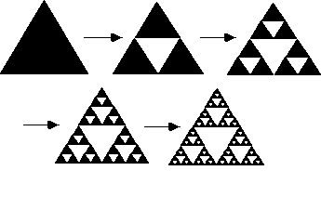
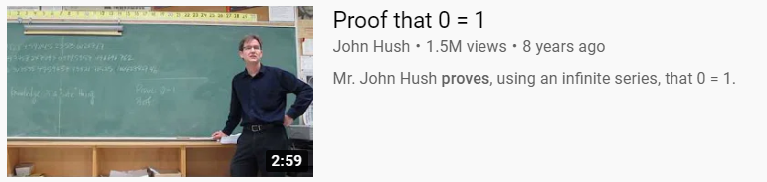
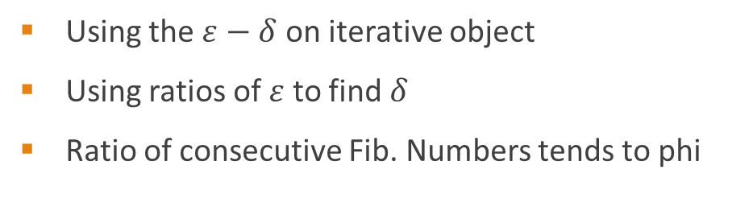
What We Learnt
Dots (…) cause us to assume unsaid stuff
Infinite processes can be defined iteratively
Initial seed values can affect the process
Have a definition for convergence
Once the expression is grounded into definitions, we can work with it
*Disclaimer*
Using the $ε−δ$ on iterative object
Using ratios of $ε$ to find $δ$
Ratio of consecutive Fib. Numbers tends to phi

Slide 21
Thank you for listening!
Questions?

Slide 22
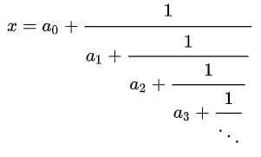

Khinchin Constant
Thm.
Every real number has a unique simple continues fraction representation
Khinchin’s Constant
For almost all real numbers,
This is bizarre, can’t we construct any infinite sequence of integers?
(*Partial denoms. are positive)

Slide 24
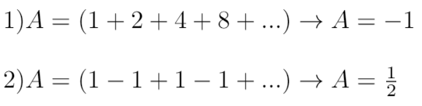
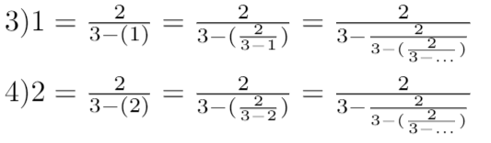
When Infinity Becomes Tricky
Makes assumption of convergence!
This trick doesn’t work for infinite processes that are not self-similar

Slide 25
The different variables to control
Initial seed
The definition of iterative process to look like what we have written
Ex. -1+1-1+1-1+1-…,
Infinity isn’t something that we can wrap our minds around, but we can break it down however is convenient for us so we can digest it bit by bit

Slide 26
Conclusion
Next time you see an infinite expression with “…”, be skeptical and ask what does the writer wants us to assume the iterative processes to be.

